Slide 1
FACIAL RECOGNITION-BASED ATTENDANCE MONITORING SYSTEM
NAME : TAPAI GHOSH
DEPT : CSE , 4th YEAR
ROLL NO : 28100117024
REGISTRATION NO : 172810110048

Slide 2
CONTENTS
Abstract
Bsic Structure
Technology and Tools
Workflow
Conclusion and Future Scope
Make Attendance

Slide 3
ABSTRACT
Attendance is an important part of daily classroom. Nowadays, Machine Learning has been highly explored for computer vision applications. So, I’ll use the concept of machine learning in Face-Recognition for automatic attendance systems. In this project, I will perform the face recognition and face detection algorithms, to provide the computer systems the ability of finding and recognizing human faces in images so that the systems can be used in giving attendance.

Slide 4
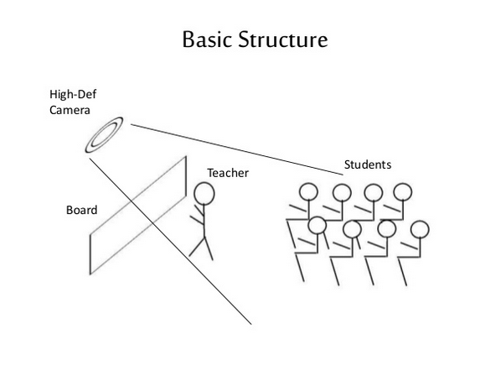

Slide 5
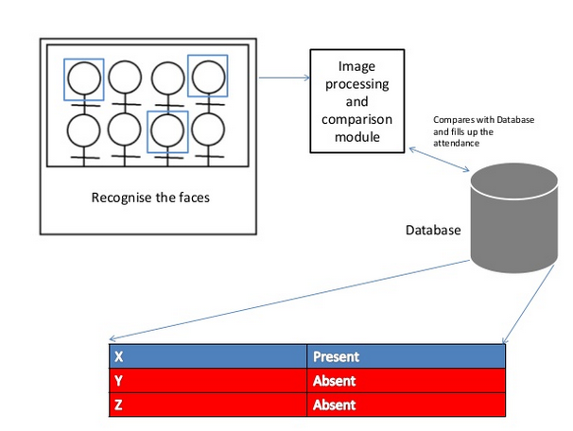

Slide 6
TECHNOLOGY AND TOOLS
Python
OpenCV
Excel
HOG Algorithm
Face Landmark Estimation Algorithm

Slide 7
WORKFLOW
Capturing image Face detection Image Processing
Attendance Face Recognition Training Set
Marker

Slide 8
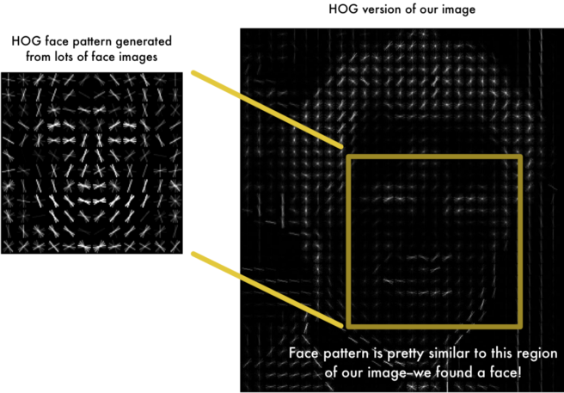
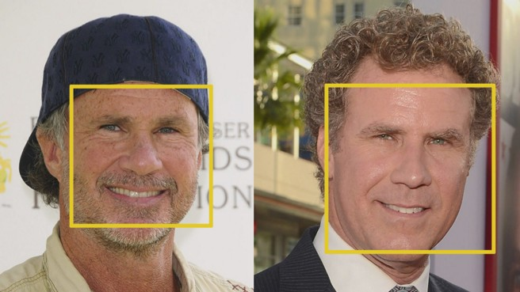
Step 1: Finding all the Faces
I need to locate the faces in a photograph.I am going to use a method called Histogram of Oriented Gradients — or just HOG for short.
Then I look at every single pixel in our image one at a time.we want to draw an arrow showing in which direction the image is getting darker.

Slide 9
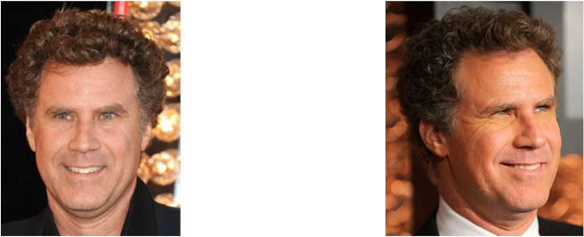

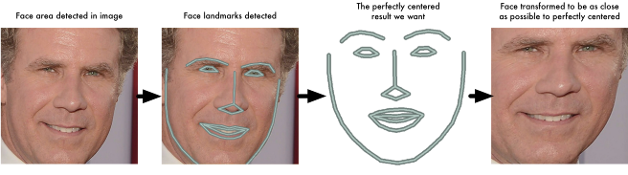
Step 2: Posing and Projecting Faces
Now I have to deal with the problem that faces turned different directions look totally different to a computer
I am going to use an algorithm called face landmark estimation. The basic idea is we will come up with 68 specific points (called landmarks) that exist on every face — the top of the chin, the outside edge of each eye, the inner edge of each eyebrow, etc.

Slide 10
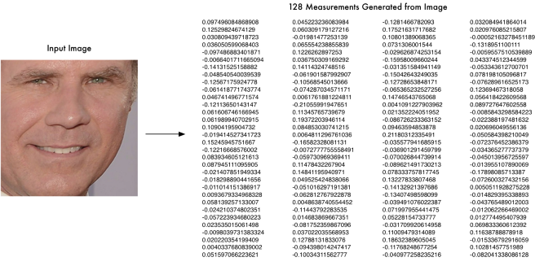
Step 3: Encoding Faces
The simplest approach to face recognition is to directly compare the unknown face we found with all the pictures we have of people that have already been tagged.
The solution is instead of training the network to recognize pictures objects, we are going to train it to generate 128 measurements for each face.

Slide 11
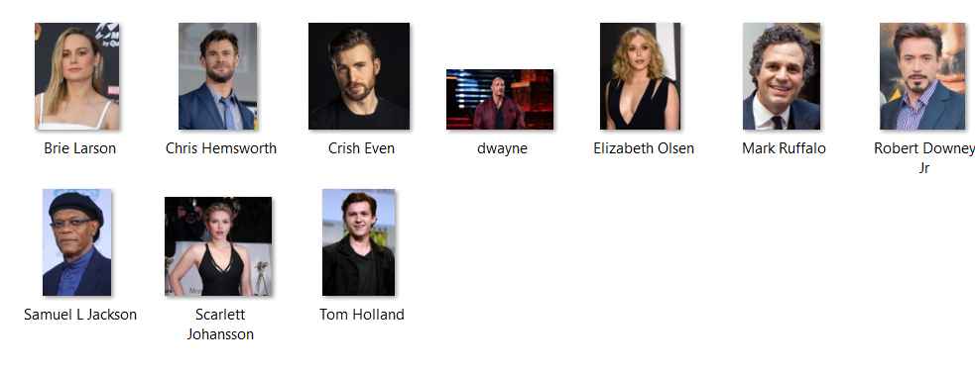
Step 4: Finding the person’s name from the encoding
This last step is actually the easiest step in the whole process. All we have to do is find the person in our database of known people who has the closest measurements to our test image.That’s our match. The result of the classifier is the name of the person!

Slide 12
CONCLUSION AND FUTURE SCOPE
Attendance maintenance is a significant function. The organization must face hard problems to maintain all the paper or file based attendance record and taking attendance manually is very time consuming.
Future Scope : On this project, there is some further works to do for alert the student by sending SMS regarding his, her attendance.

Slide 13
THANK YOU !!

